Slide 1



Function
Algorithm and Programming Techniques
Rizka Wakhidatus Sholikah

Slide 2



Outline
What is function?
Syntax
Call a function
Declaration
Definition
Parameters and Arguments
Default parameter value
Multiple parameter
Pass by value vs pass by reference
www.its.ac.id
INSTITUT TEKNOLOGI SEPULUH NOPEMBER, Surabaya - Indonesia

Slide 3
Function
Function is a block of code that perform certain task
Example:
Function to sum, function to multiply
Function main
Function is important for reusability
We can use a function so many times whenever it is needed
Function only execute when it is called
www.its.ac.id
INSTITUT TEKNOLOGI SEPULUH NOPEMBER, Surabaya - Indonesia

Slide 4
Syntax
Syntax to write function in C++
returnType functionName(){
// code to be executed
}
www.its.ac.id
INSTITUT TEKNOLOGI SEPULUH NOPEMBER, Surabaya - Indonesia

Slide 5
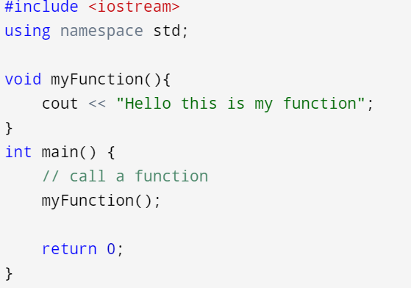
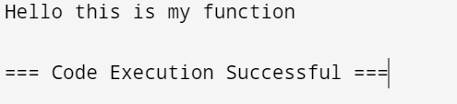
Call a function
Calling a function in C++
www.its.ac.id
INSTITUT TEKNOLOGI SEPULUH NOPEMBER, Surabaya - Indonesia

Slide 6
Declaration and Definition
void myFunction() { // declaration // the body of the function (definition) }
Declaration consist of return type, name of function, and parameters (if any)
Definition the body of function
www.its.ac.id
INSTITUT TEKNOLOGI SEPULUH NOPEMBER, Surabaya - Indonesia

Slide 7
Note:
int main() { myFunction(); return 0; } void myFunction() { cout << "I just got executed!"; }
// Function declaration void myFunction(); // The main method int main() { myFunction(); // call the function return 0; } // Function definition void myFunction() { cout << "I just got executed!"; }
www.its.ac.id
INSTITUT TEKNOLOGI SEPULUH NOPEMBER, Surabaya - Indonesia

Slide 8
Parameters and Arguments
Parameters is information that passed to function
Parameters can be written inside the parentheses
We can use more than one parameters, separated by comma
void functionName(parameter1, parameter2, parameter3) { // code to be executed }
www.its.ac.id
INSTITUT TEKNOLOGI SEPULUH NOPEMBER, Surabaya - Indonesia

Slide 9
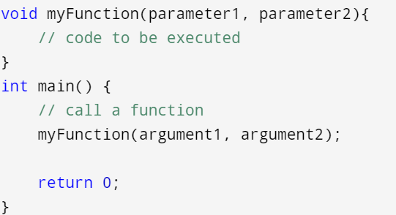
Parameters and Arguments
Arguments are actual value that passed to the function
www.its.ac.id
INSTITUT TEKNOLOGI SEPULUH NOPEMBER, Surabaya - Indonesia

Slide 10
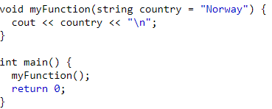
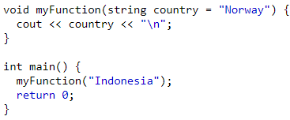

Default parameter value
In a function we can use default parameter using sign “=“
www.its.ac.id
INSTITUT TEKNOLOGI SEPULUH NOPEMBER, Surabaya - Indonesia

Slide 11
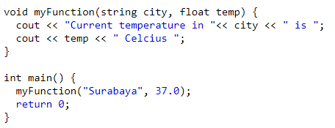
Multiple parameters
www.its.ac.id
INSTITUT TEKNOLOGI SEPULUH NOPEMBER, Surabaya - Indonesia

Slide 12
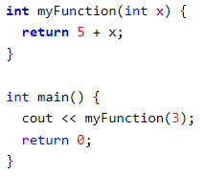
Return values
In previous example the function has data type “void”
Means the function should not return a value
If we want a function to return a value, we canuse int, float, string, etc.
www.its.ac.id
INSTITUT TEKNOLOGI SEPULUH NOPEMBER, Surabaya - Indonesia

Slide 13
Pass by reference
Passing the address of an argument in the calling function
Passing by reference used if we want to modify the argument value inside the calling function
www.its.ac.id
INSTITUT TEKNOLOGI SEPULUH NOPEMBER, Surabaya - Indonesia

Slide 14
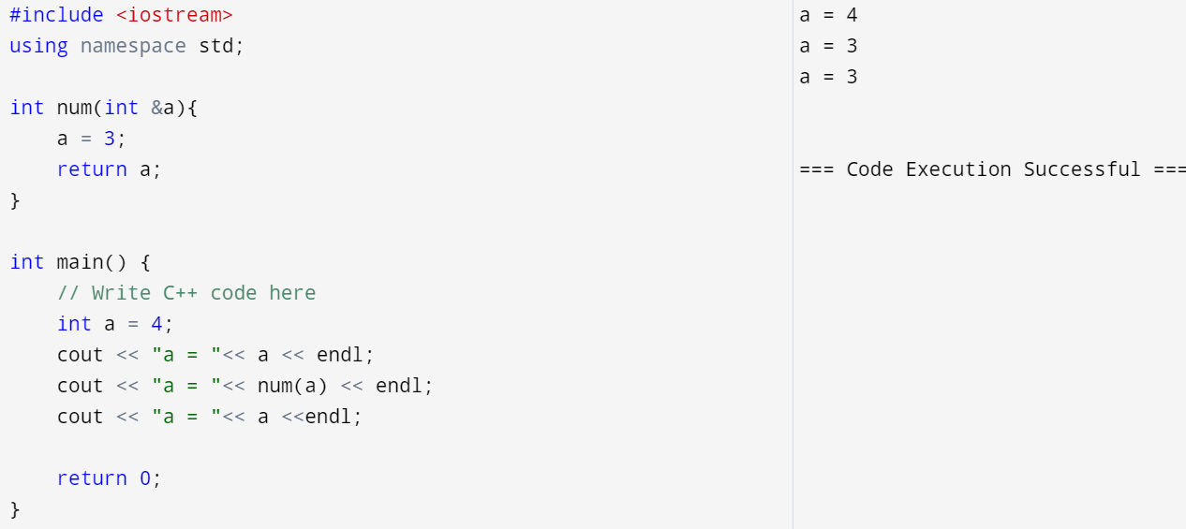
Pass by reference
www.its.ac.id
INSTITUT TEKNOLOGI SEPULUH NOPEMBER, Surabaya - Indonesia

Slide 15
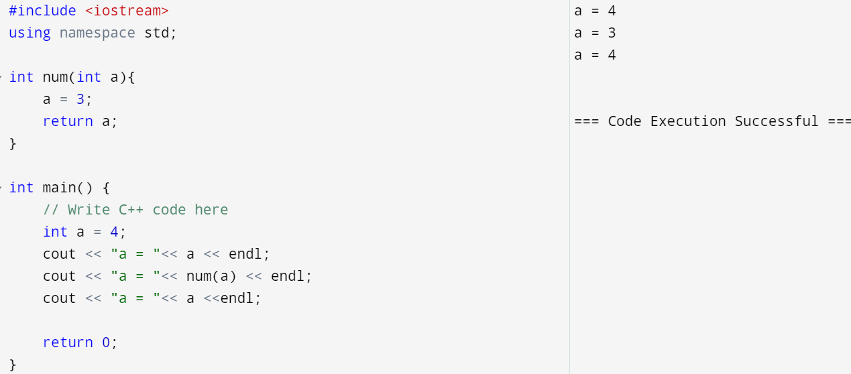
Pass by value
www.its.ac.id
INSTITUT TEKNOLOGI SEPULUH NOPEMBER, Surabaya - Indonesia

Slide 16
Exercise
Modify your calculator code
Create a function for each functionality
Function to sum
Function to substract
Function to multiply
Function to divide
Don’t forget to add the comments in your code
Happy coding ☺
www.its.ac.id
INSTITUT TEKNOLOGI SEPULUH NOPEMBER, Surabaya - Indonesia

Slide 17
Thank you

